Slide 1
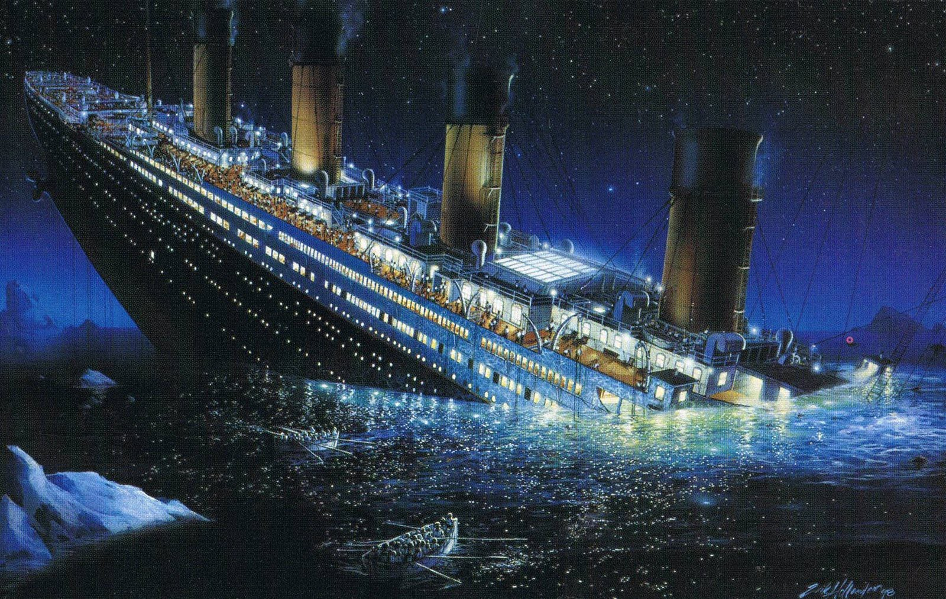
Titanic - Machine Learning from Disaster
Group 5: Ahmed Moustafa, Rohit Kala, and Justin Kilgo

Slide 2
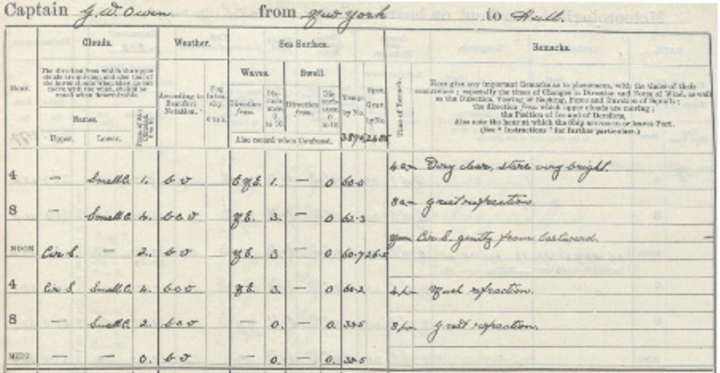
Context
The RMS Titanic sank in the early morning hours of 15 April 1912 in the North Atlantic Ocean.
Britain & the US launched an investigation which produced extensive tables of passengers and crew, broken down by age group, gender, class and survival (July 1912).
According to investigations, ~1500 people died
This data was organized and packaged for Data Analysis in December of 1999 → Kaggle competition.
What are some of the difficulties of using such old paper-sourced data?

Slide 3






Key Technologies
Python Pandas
Jupyter Notebook – Google Colaboratory
Python Libraries for Data Analysis + Training:
numpy
seaborn
sklearn
xgboost

Slide 4
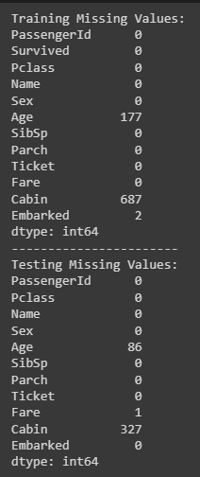
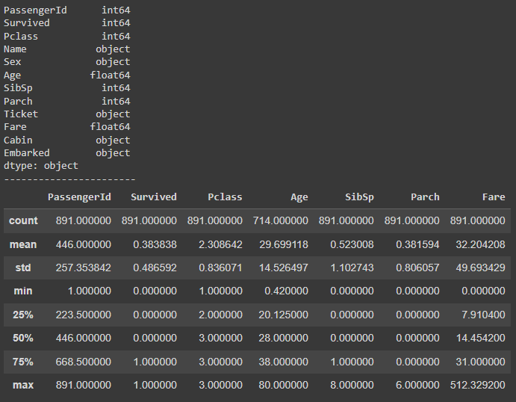
Exploratory Data Analysis
Training DataFrame (891 of 1309 total):

Slide 5
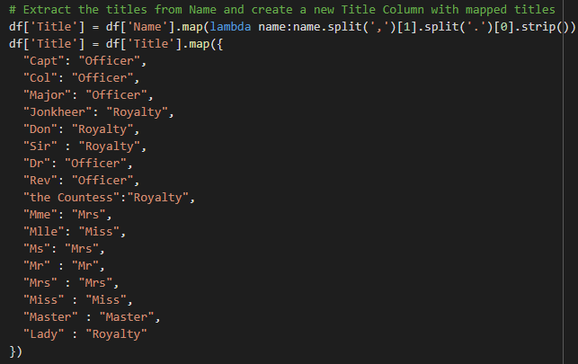
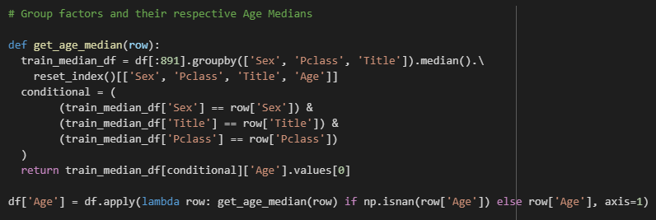
Data Preprocessing
Combine the train & test DataFrames to unify preprocessing changes

Slide 6
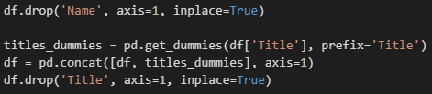
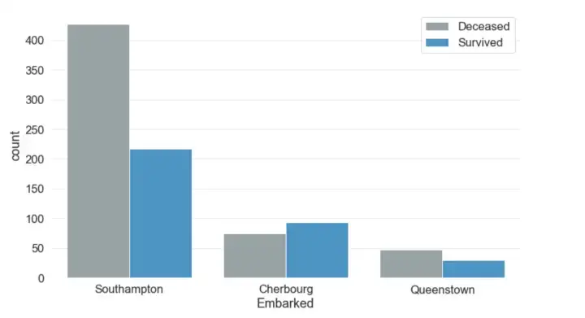
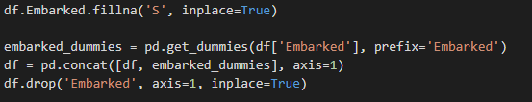
Data Preprocessing
The name column doesn’t provide much information for survival so we can drop it.
After mapping the Titles, we can dummy encode them
Embarked tells us the city of departure. S is the mode so we use that to fill in null rows and dummy encode

Slide 7
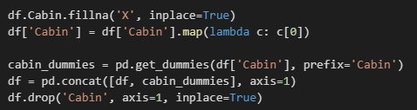
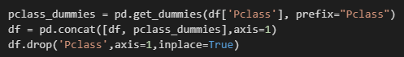
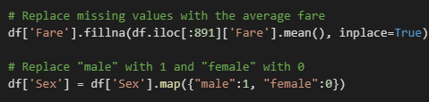
Data Preprocessing
We denoted null Cabin values with an ‘X’ and dummy encoded using the 1st letter (train on sections of the ship rather than specific rooms)
Pclass gave us the status of the passengers: class-1 > class-2 > class-3. We also dummy encoded this.
Remaining Preprocessing

Slide 8
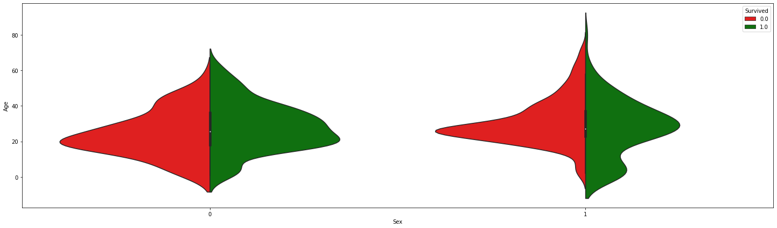
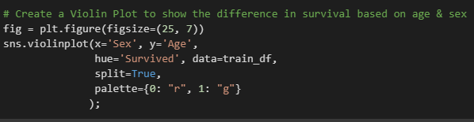
Age & Sex Survival Analysis
female
male

Slide 9
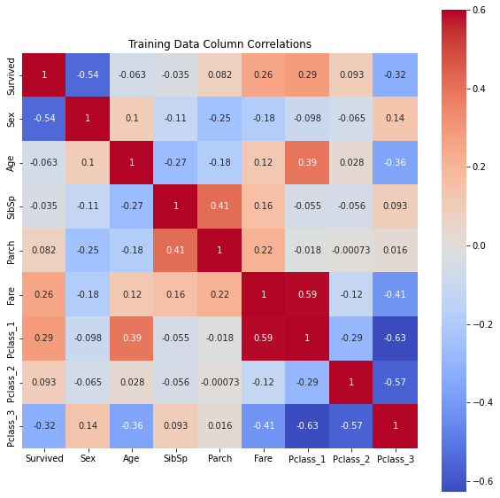
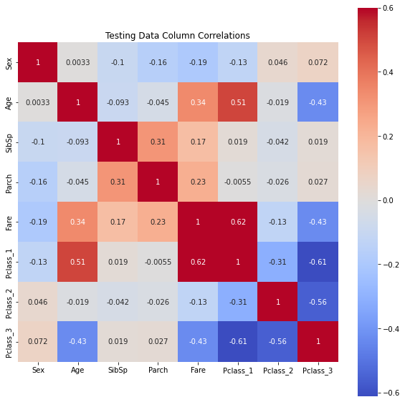
More Data Analysis
Seaborn heatmaps

Slide 10
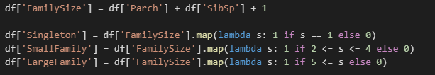
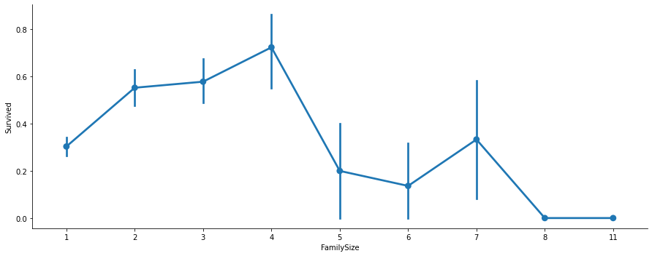
Feature Engineering
Parch and SibSp can be combined to represent the # of people a person was with (spouse, parents, siblings → FamilySize).
Seaborn
factorplot

Slide 11
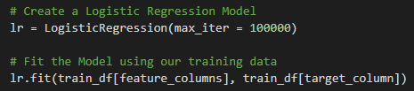
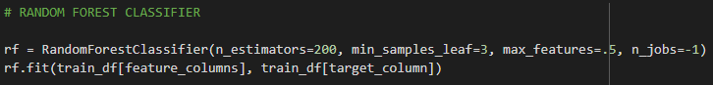
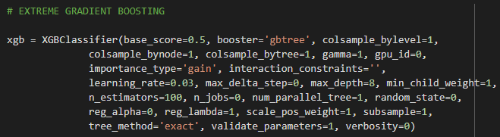
Models

Slide 12
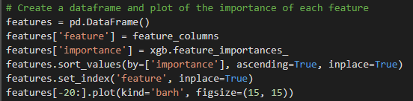
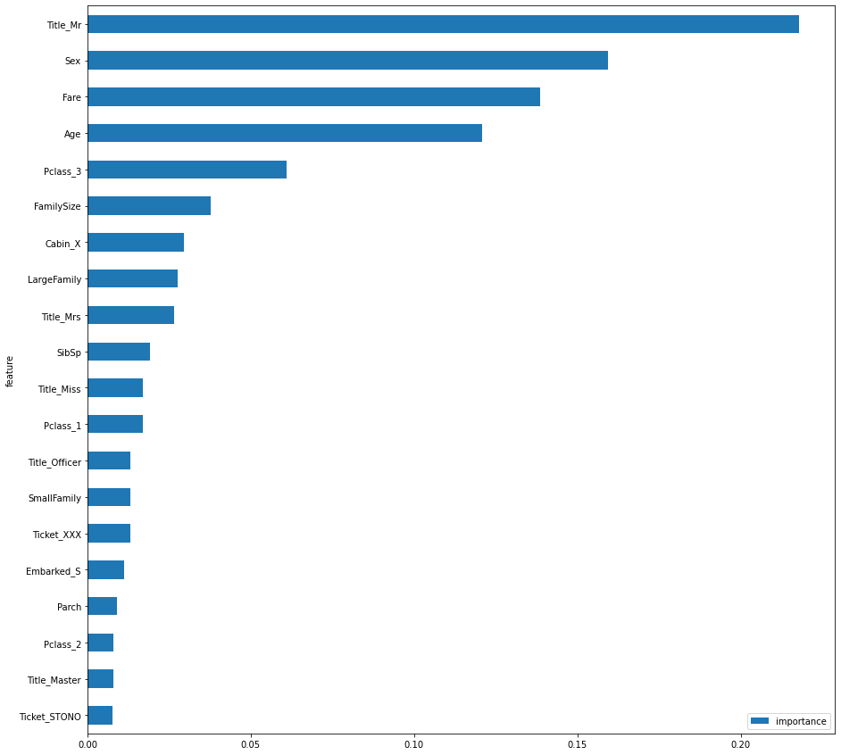
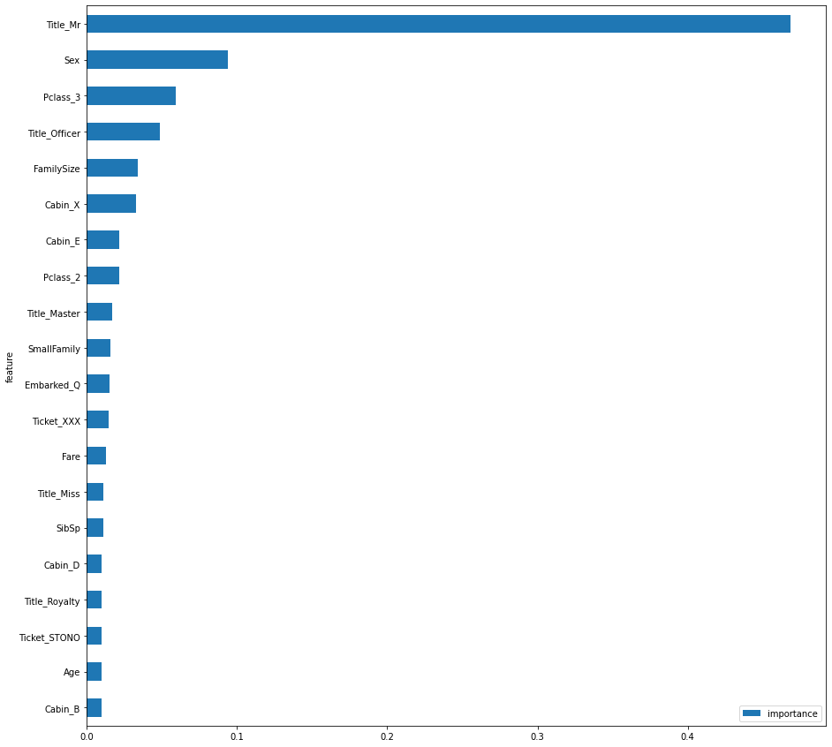
Feature Importance
Random Forest
XGB

Slide 13
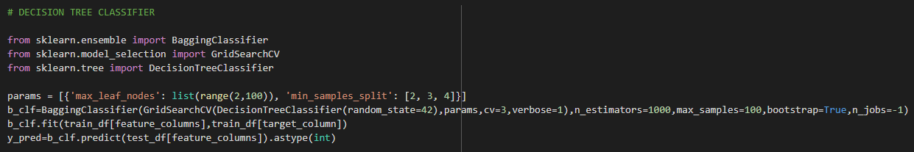
Meta Model
A Bagging classifier is “an ensemble meta-estimator that fits base classifiers each on random subsets of the original dataset and then aggregate their individual predictions.”
bootstrap = True → samples are drawn w/ replacement
n_jobs = -1 → all processors used to run jobs in parallel

Slide 14
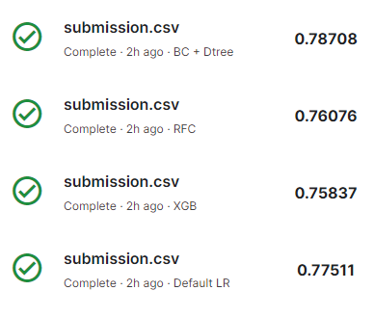
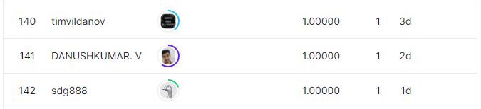
Evaluation
Future Improvements
Decision Tree with the Bagging Classifier was our best model → top 8%
Only gained ~1% over Logistic Regression!
Over 140 cheaters
More feature engineering and fine-tuning models

Slide 15
References
https://rss.onlinelibrary.wiley.com/doi/10.1111/j.1740-9713.2019.01229.x
https://www.kaggle.com/competitions/titanic
https://towardsdatascience.com/encoding-categorical-variables-one-hot-vs-dummy-encoding-6d5b9c46e2db#:~:text=Both%20expand%20the%20feature%20space,avoids%20the%20dummy%20variable%20trap.
https://towardsdatascience.com/a-beginners-guide-to-kaggle-s-titanic-problem-3193cb56f6ca#:~:text=Embarked%20implies%20where%20the%20traveler,the%20rest%20boarded%20from%20Queenstown.
https://xgboost.readthedocs.io/en/stable/parameter.html
https://scikit-learn.org/stable/modules/generated/sklearn.ensemble.BaggingClassifier.html

